Slide 1

ONLINE TRAIN TICKET RESERVATION SYSTEM - SRINIVAS TICKET RESERVATION
Project Supervisor: Dr. A. Jesudoss
Name of the Student: P . Srinivasa prasad
Register Number: 39110775

Slide 2
Presentation Outline
Introduction
Objectives
System Architecture / Ideation Map
Project Implementation
Methodology
Summary
Conclusion
References

Slide 3
Introduction
The aim of this application is to help the users to book train tickets in an affordable cost and time.
In this app, admin can login and manage the reserved users and they can give concession and refund as per their wish.
The code of this application is done from scrach, front-end with HTML, CSS, JS and Bootstrap and back-end with MYSQL and PHP.

Slide 4
Objectives
To build a web based application for online train ticket reservation system Angular JS.
The scope involves the admin to control the registered passengers and the refund policies.
The objective is achieved by coding from scratch and the languages used are HTML, CSS ,JS ,Bootstrap , MySQL , PHP.

Slide 5
System Architecture / Ideation Map
User
Home
Reserve Now
Select Schedule
Select Accommodation
Passenger Info
Payment Info
Ticket Confirmation
Back to home

Slide 6
Project Implementation
Create workspace and implement the basic frontend part of the website using the frontend languages.
Create components and make their layout with HTML, CSS and JavaScript.
Create the features with PHP.
Build routes/links in between the components.
Connect the app to backend mysql database.

Slide 7
Methodology
The first step is to code for the desired pages for the ticket reservation system from scratch i.e. Visual Studio Code.
In this website the home page contains the about details, contact details, and the extra features offered by the tickets ready website.
And there is a feature for admin where he/she can control those who are booking tickets by accepting their payment, declining, an giving concession etc.

Slide 8
Methodology
Once after the user clicks register now button, he/she will be directed to a page where he/she should book their schedule of travel like journey date, boarding place and destination place.
After booking the schedule of travel, the user will be directed to a page where he/she should select the accommodation of travel and should enter the number of passengers.
The task after entering the number of passengers is to give the details of who books the ticket and the passengers’ info in passenger info page.

Slide 9
Methodology
Once after the passengers info is entered, the final booking will be done and the ticket will be generated with all information such as booked person, passengers’ info, boarding place, destination place and the fare for the ticket.
As mentioned before, there will be a separate login for admin, the admin can login to the portal and control those who are booking tickets by accepting their payment, declining, an giving concession etc.
The details of all before mentioned activities gets collected in MySQL database and that acts as the backend server.
After all these methods, finally the Tickets Ready website for booking railway tickets online is successfully done.

Slide 10
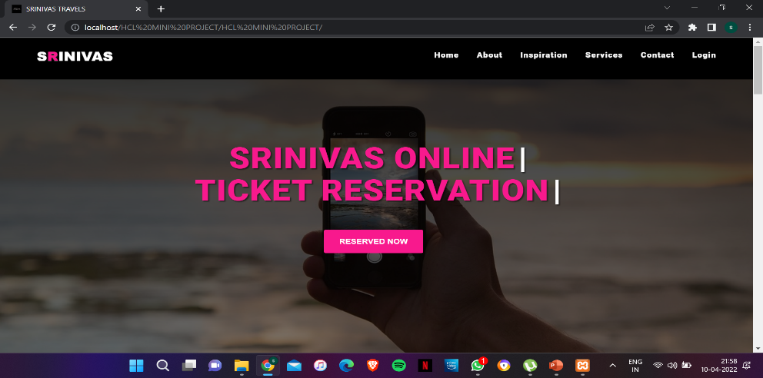
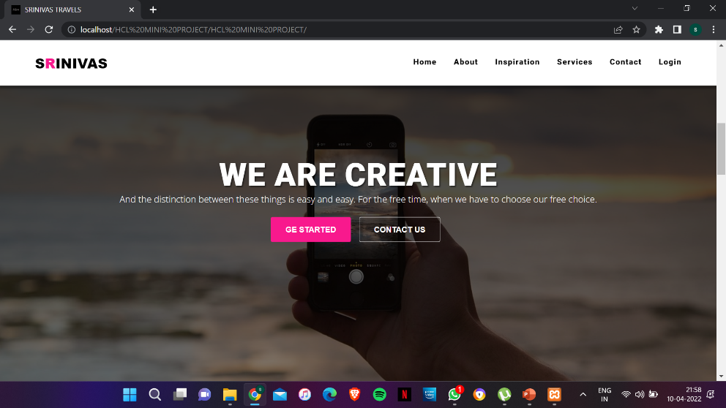
Application Snapshots
Home Page:

Slide 11
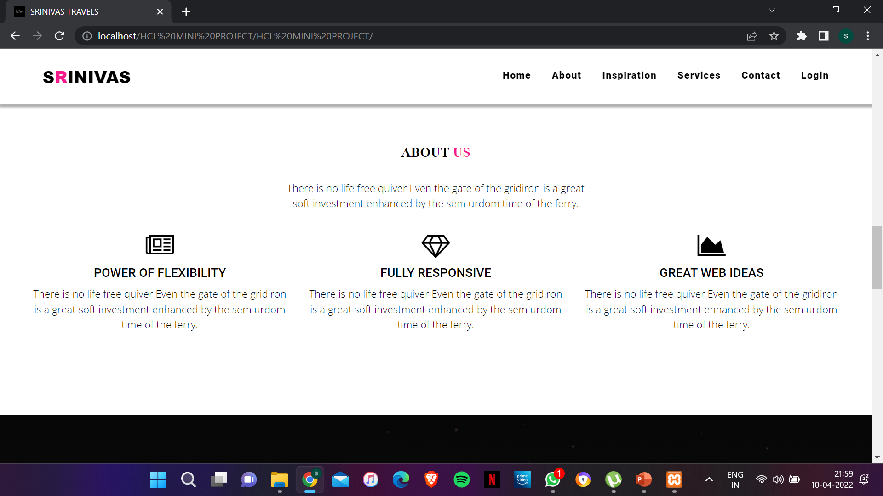
Application Snapshots
About Us Page:

Slide 12
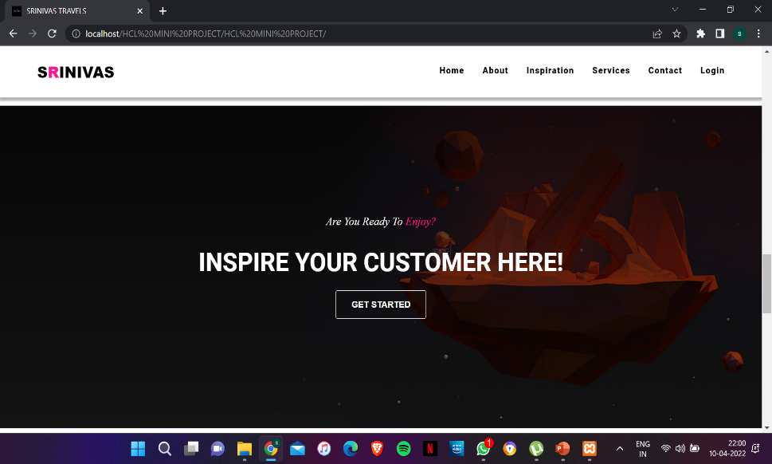
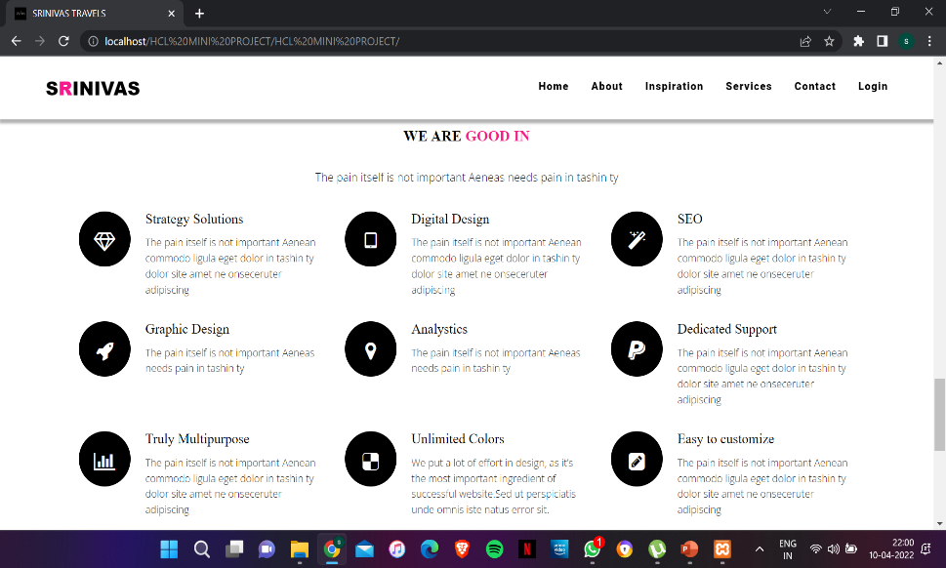
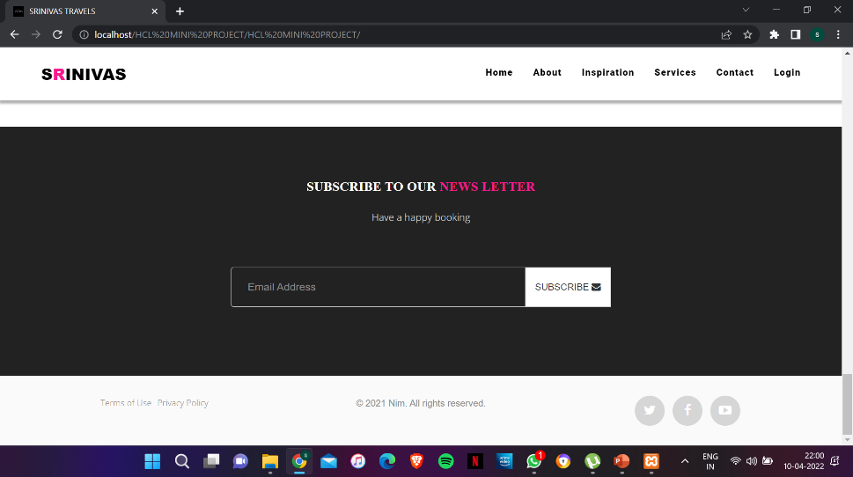
Application Snapshots
Contact Page:
Services Page:

Slide 13
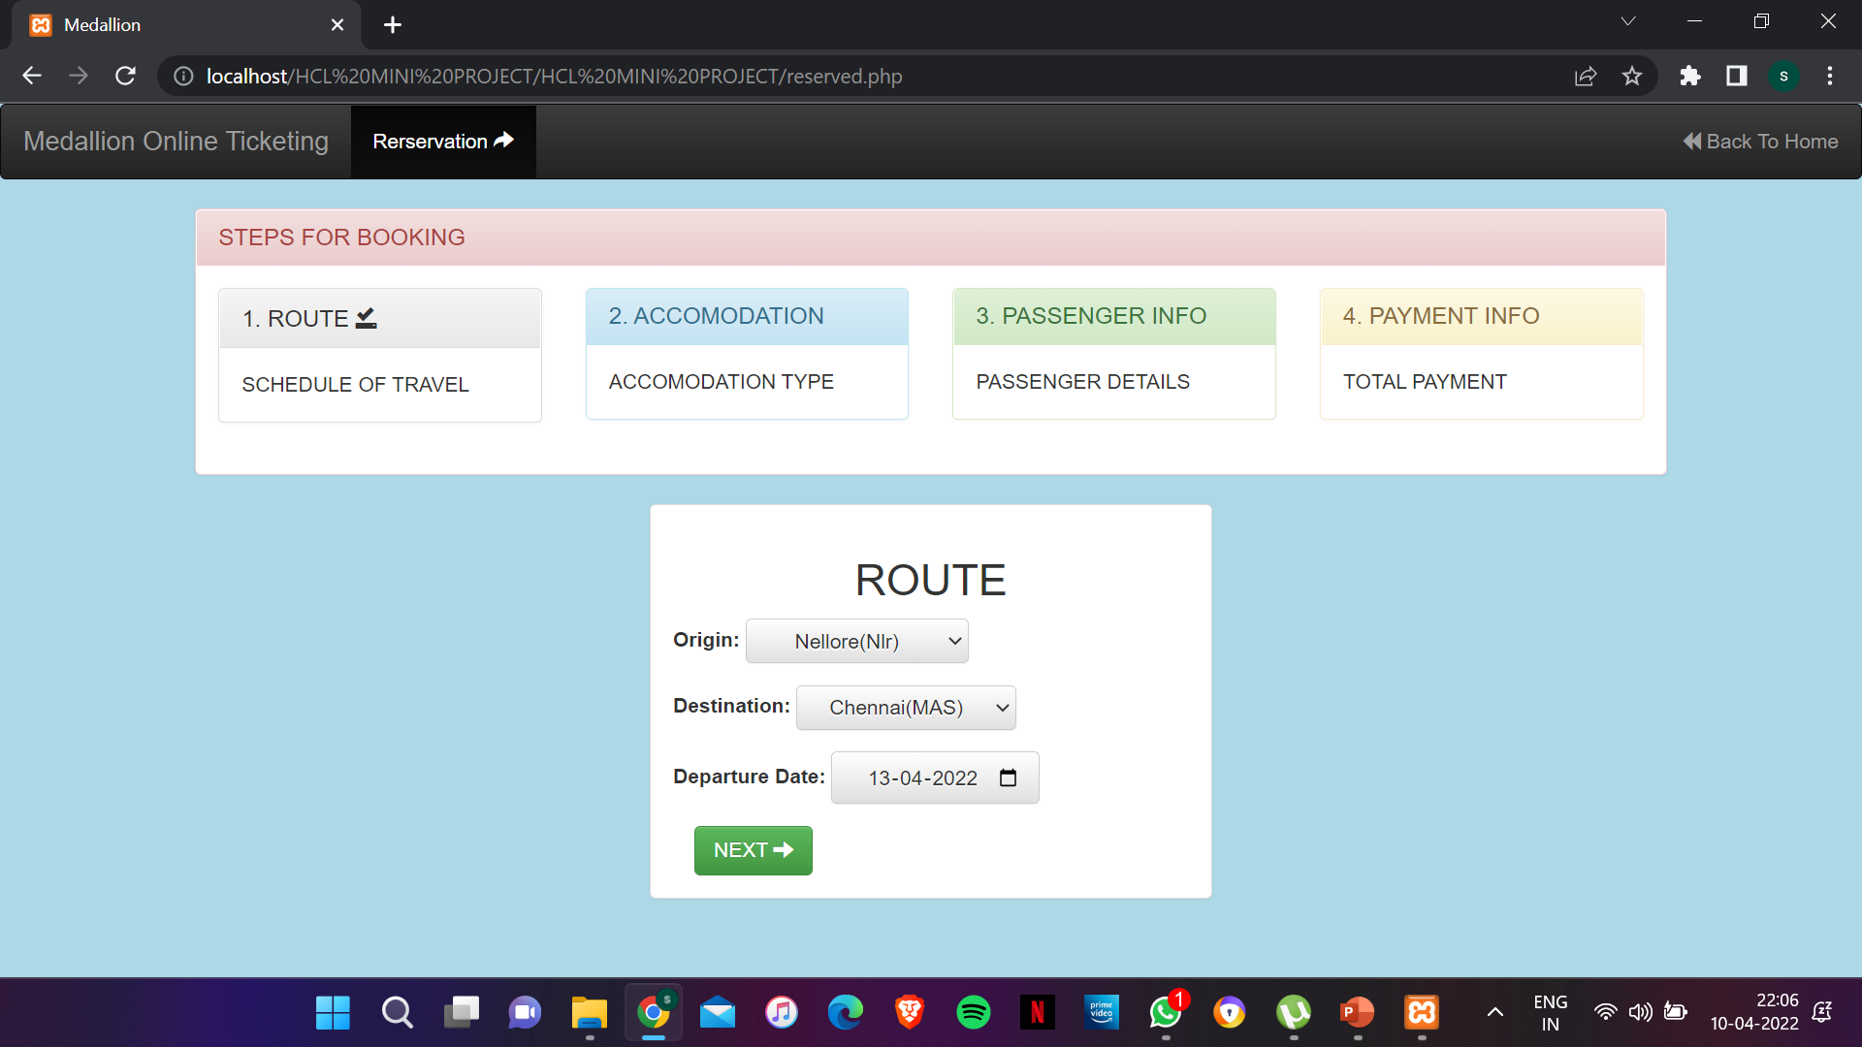
Application Snapshots
Schedule Page:

Slide 14
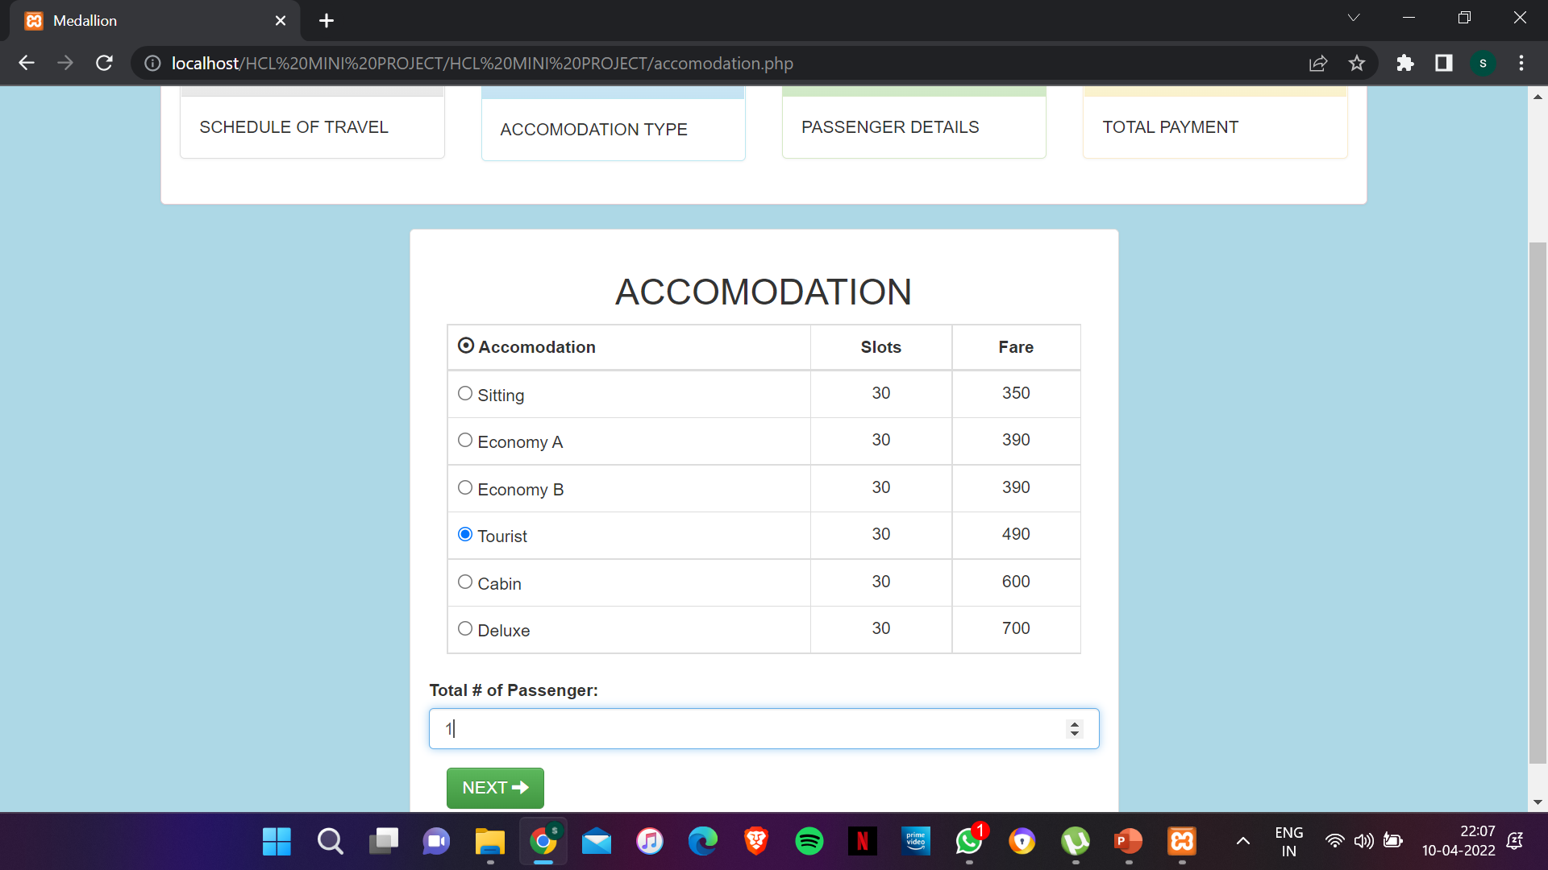
Application Snapshots
Accommodation Page:

Slide 15
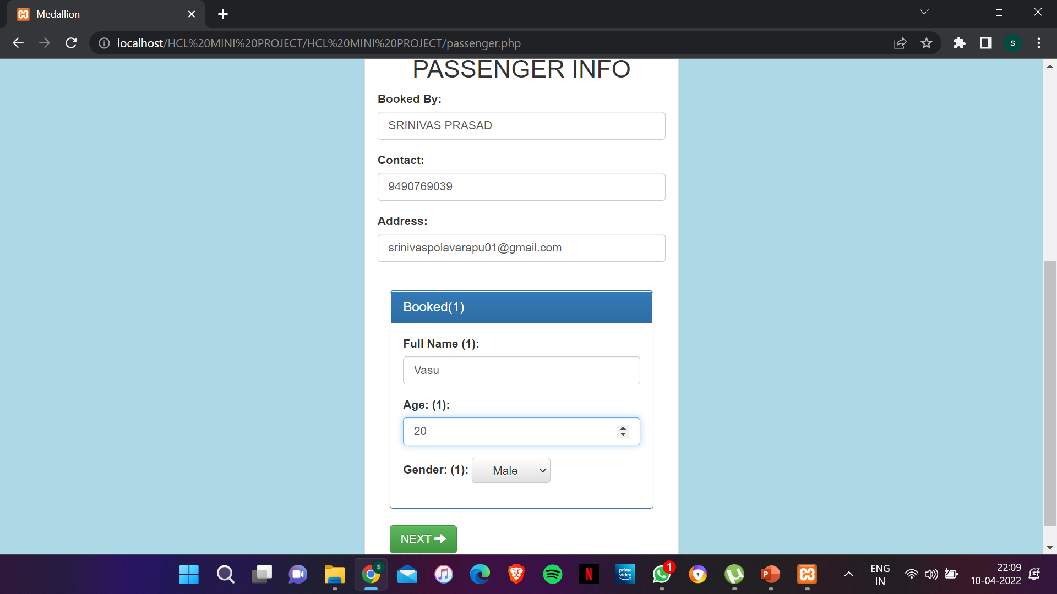
Application Snapshots
Passenger Info Page:

Slide 16
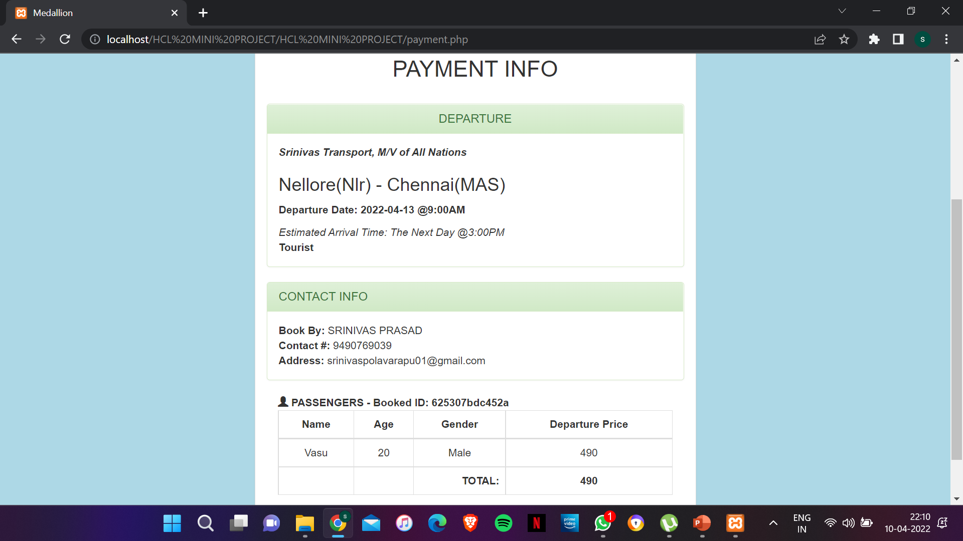
Application Snapshots
Payment Info Page:

Slide 17
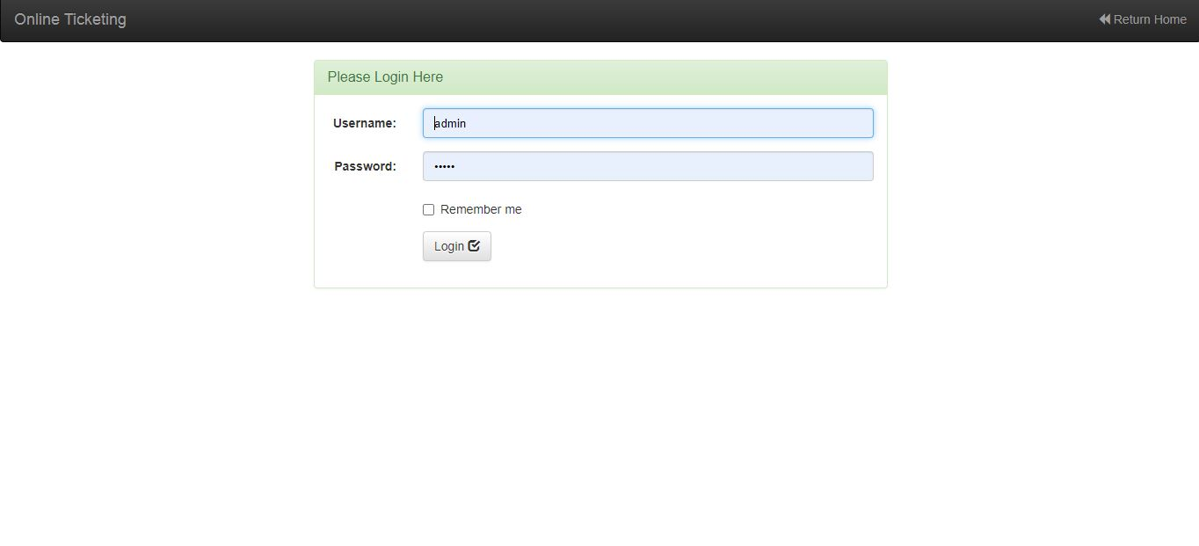
Application Snapshots
Admin Login Page:

Slide 18
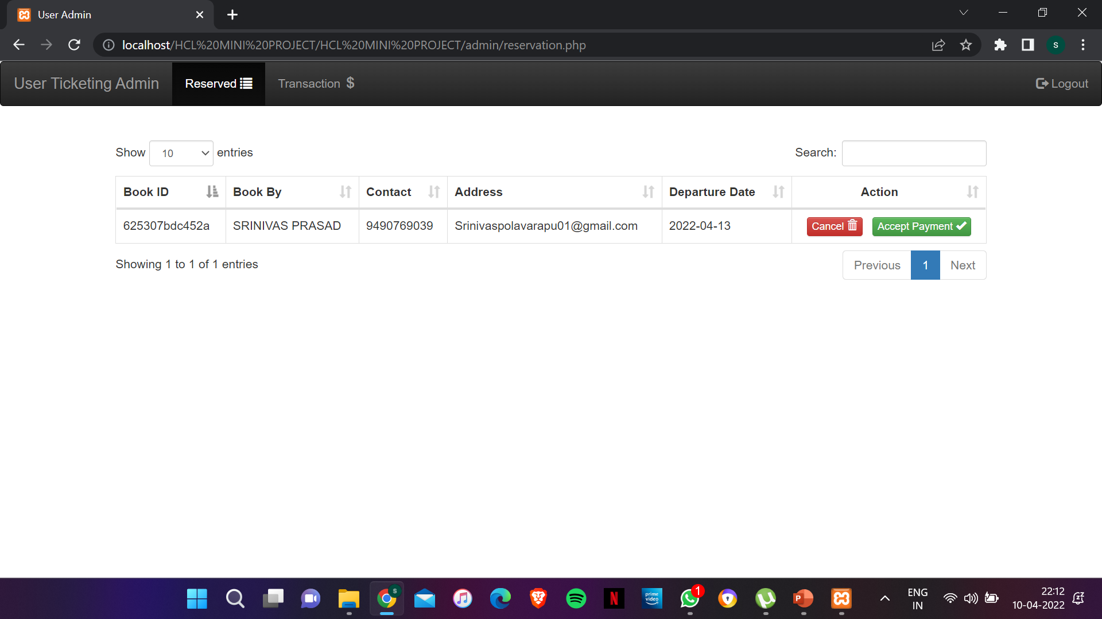
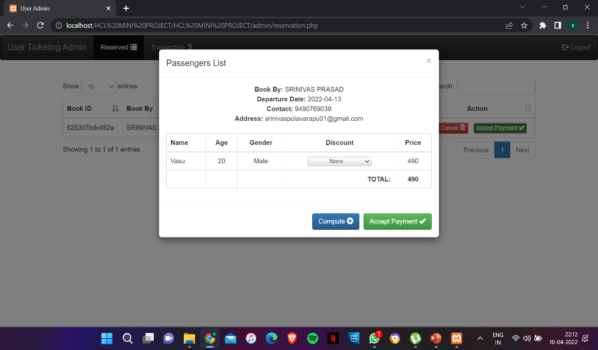
Application Snapshots
Reserved User Portal: Accept Payment Portal:

Slide 19
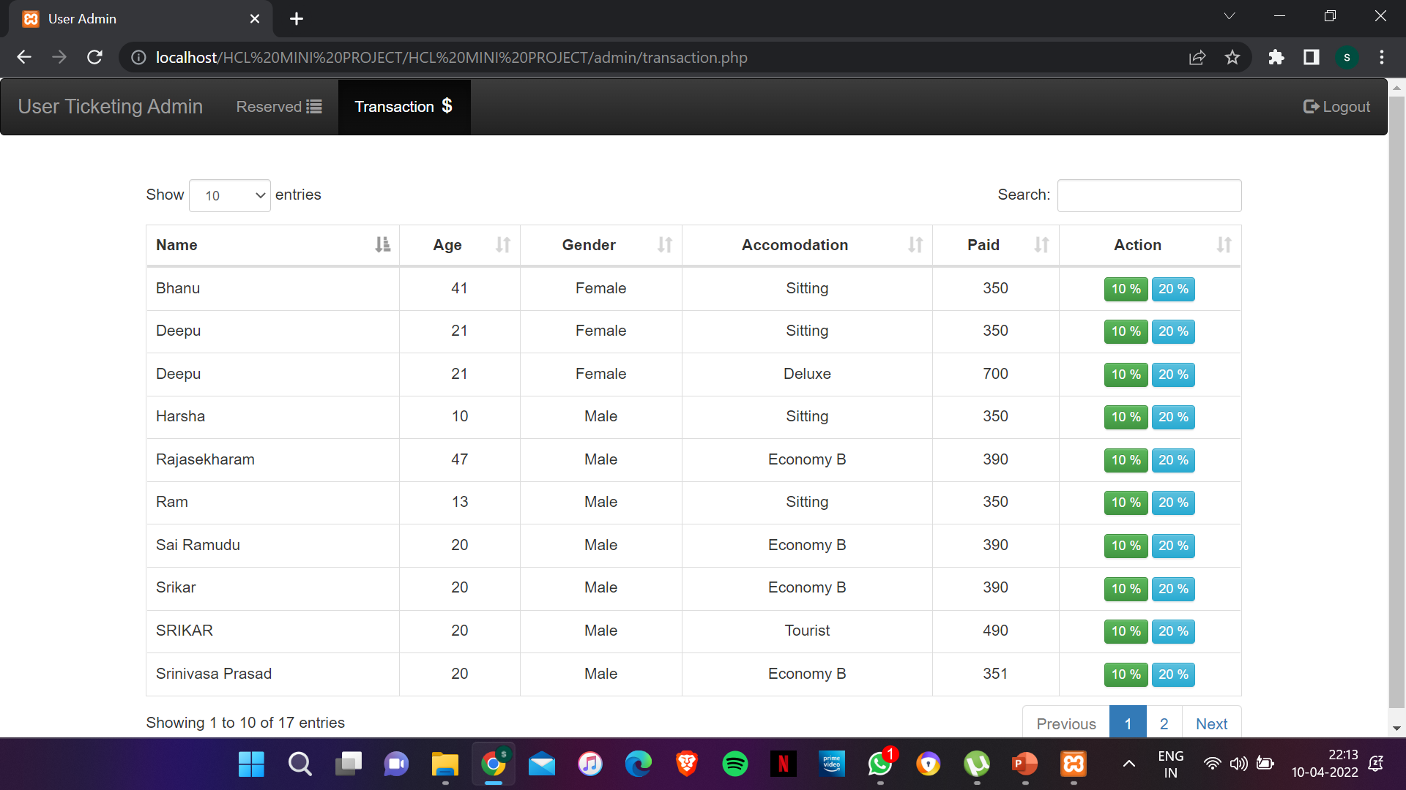
Application Snapshots
Transactions Portal:

Slide 20
Summary
This “Tickets Ready” app helps in booking your tickets in a quick manner and in affordable price for all people in the society.
In this busy and hectic world, one cannot go to the booking office to book tickets and it’s a waste of time for people who are running to earn money.
This app helps in a very good manner for those people and for female passengers it’s a very good advantage to get concession in ticket fare.
The code is done from the scratch and the layout is made. The data is passed through database and collected in mysql. This will be more helpful in booking!!!

Slide 21
Conclusion
The front-end languages such as HTML, CSS and are becoming one among the emerging languages.
This website is connected to backend and thus collecting the total details about the journey becomes very easy.
In today’s world, the web development technology is an emerging technique which helps in many real time applications and saves people time and efforts.

Slide 22
References
[1] | IRCTC – A very known central government aided ticket reservation app that can be downloaded from google play store has been taken as reference.

